Slide 1


AtliQ Hardwares
Presented by Yatin Lokhande

Slide 2

AtliQ Hardwares
Presented by Kishan Singh

Slide 3
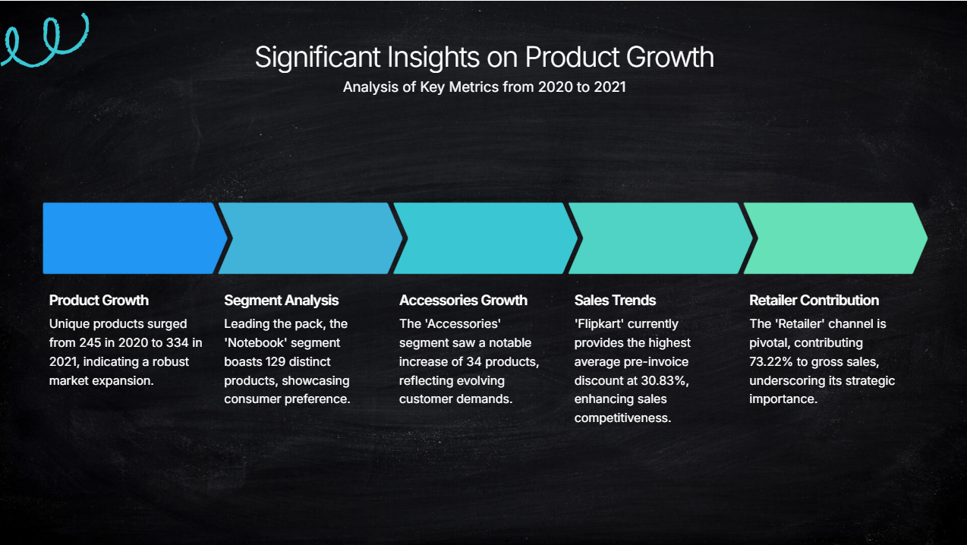
AtliQ Hardwares
Presented by Kishan Singh

Slide 4

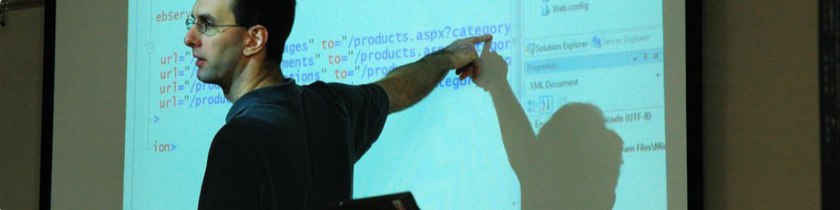
10 Adhoc requests for Analysis
Without further Ado lets dive in deeper on the various Adhoc request which gave us such valuable insights
Upcoming slides contain the Problem statement and their resolution.
AtliQ Hardwares
Presented by Kishan Singh

Slide 5
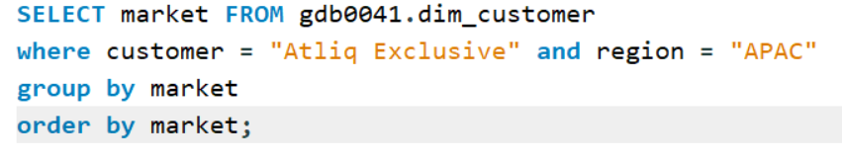
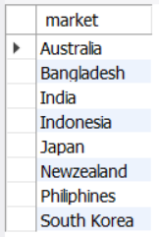
Provide the list of market in which customer Atliq Exclusive” operates its business in APAC region
AtliQ Hardwares
Presented by Kishan Singh

Slide 6
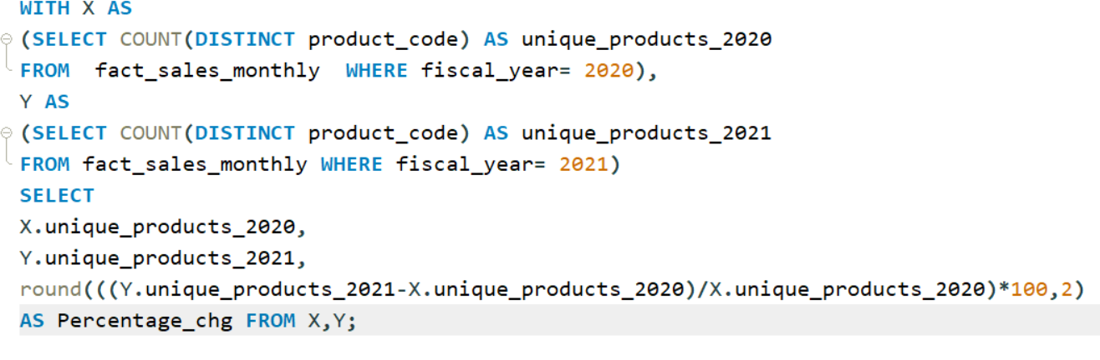
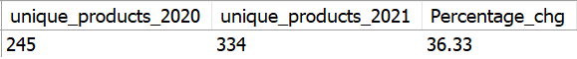
What is the percentage of unique product increase in 2021vs.2020?
AtliQ Hardwares
Presented by Kishan Singh

Slide 7
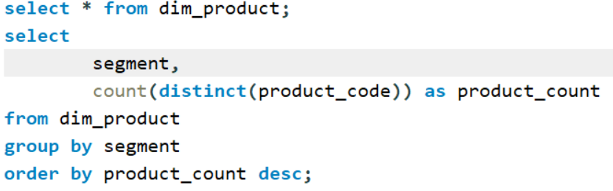
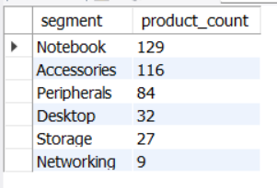
Provide a report with all the unique product counts for each segment and sort them in descending order of product counts. The final output contains 2 fields, segment product count.
AtliQ Hardwares
Presented By Kishan Singh

Slide 8
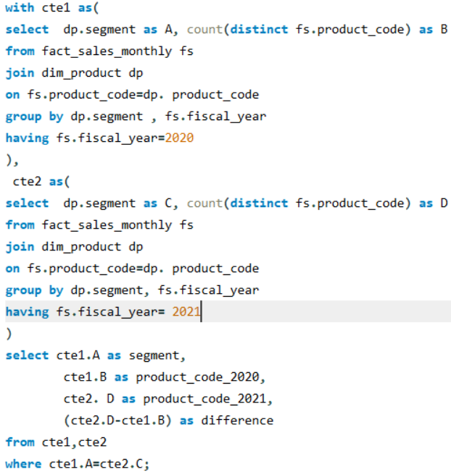
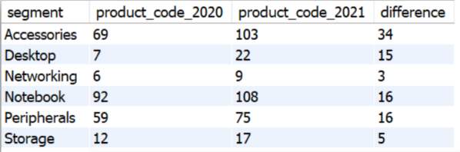
Follow-up: Which segment had the most increase in unique products in 2021 vs 2020?
The final output contains these fields, segment, product count 2020 product_count_2021 difference.
AtliQ Hardwares
Presented By Kishan Singh

Slide 9
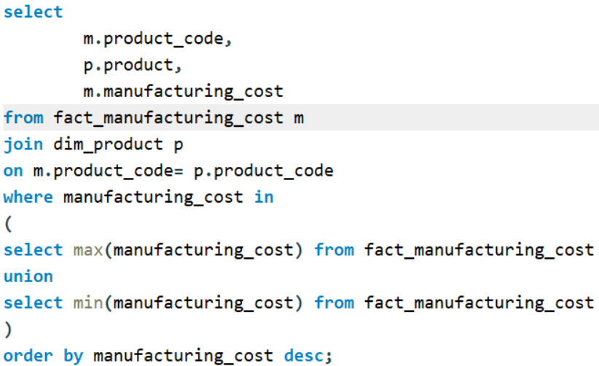
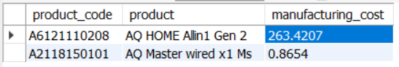
Get the products The final output that have the highest and lowest manufacturing costs
should contain these fields, product_code, product
AtliQ Hardwares
Presented By Kishan Singh

Slide 10
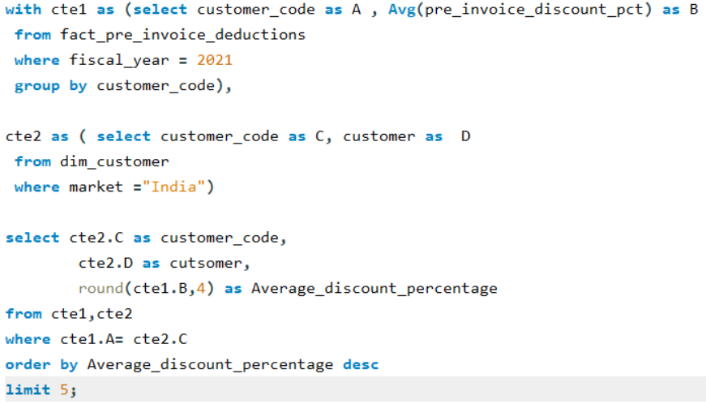
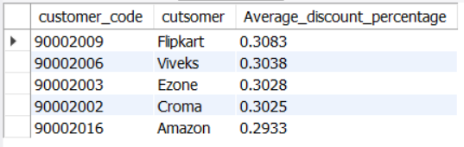
Generate a report which contains the top 5 customers who received an average high pre invoice discount_pct for the fiscal year 2021 and in the Indian market. The final output contains these fields customer_code customer average_discount_percentage.
AtliQ Hardwares
Presented by Kishan Singh

Slide 11
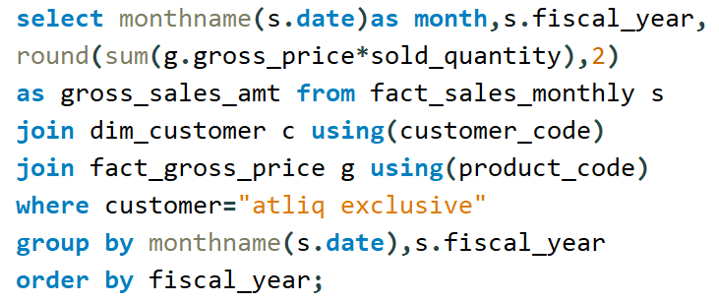
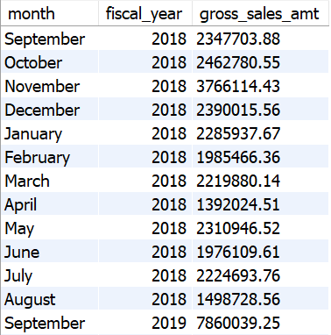
Get the complete report of the Gross sales amount for the customer "Atliq Exclusive "for each month. This analysis helps to get an idea of low and high-performing months and take strategic decisions. The final
report contains these columns: Month Year Gross sales Amount.
AtliQ Hardwares
Presented by Kishan Singh

Slide 12
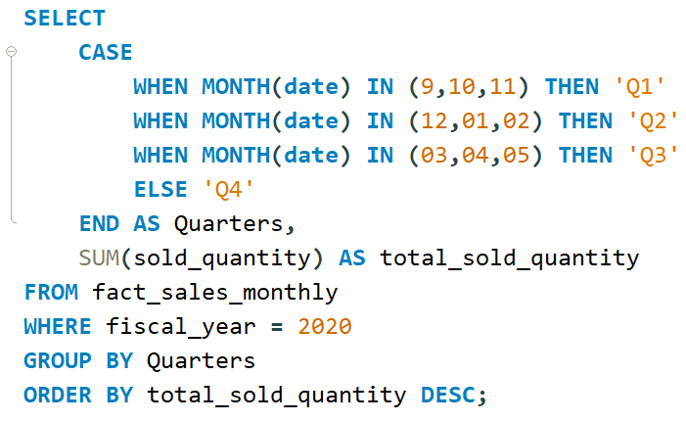
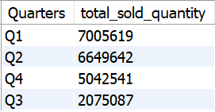
Which quarter of 2020, got the maximum total_sold_quantity? The final output contains these fields sorted by the total_sold_quantiy, Quarter,total_sold_quantity.
AtliQ Hardwares
Presented by Kishan Singh

Slide 13
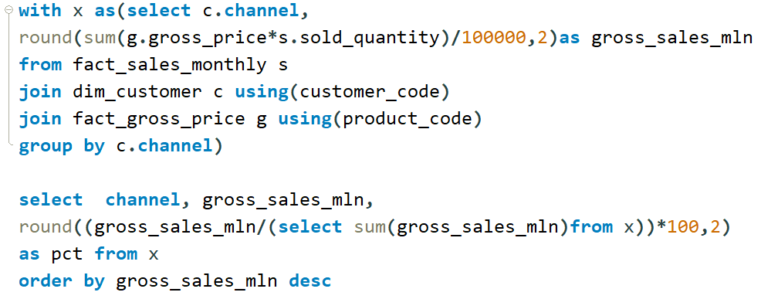
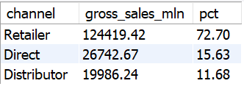
Which channel helped to bring more gross sales in the fiscal year 2021 and the percentage of contribution? The final output contains these fields, channel gross sales min percentage.
AtliQ Hardwaares
Presented by Kishan Singh

Slide 14
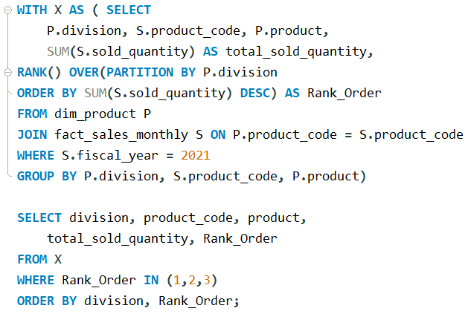
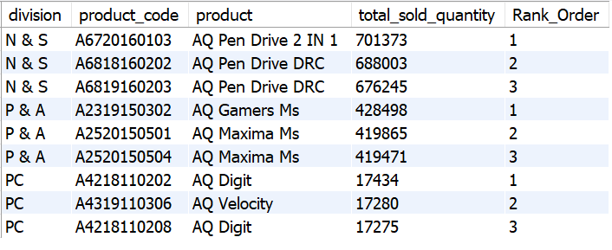
Get the Top 3 products in each division that have a high total_sold_quantity in the fiscal_year 2021? The final output contains these fields, division product_code.
AtliQ Hardwares
Presented by Kishan Singh

Slide 15
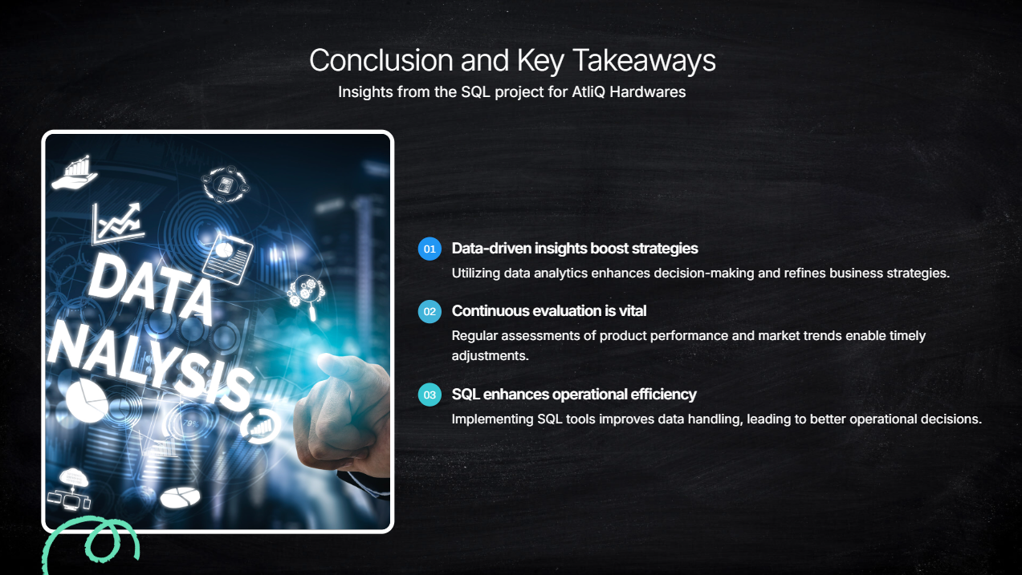
AtliQ Hardwares
Presented by Kishan Singh

Slide 16
Thank You
AtliQ Hardwares
Presented by Kishan Singh

